Slide 1
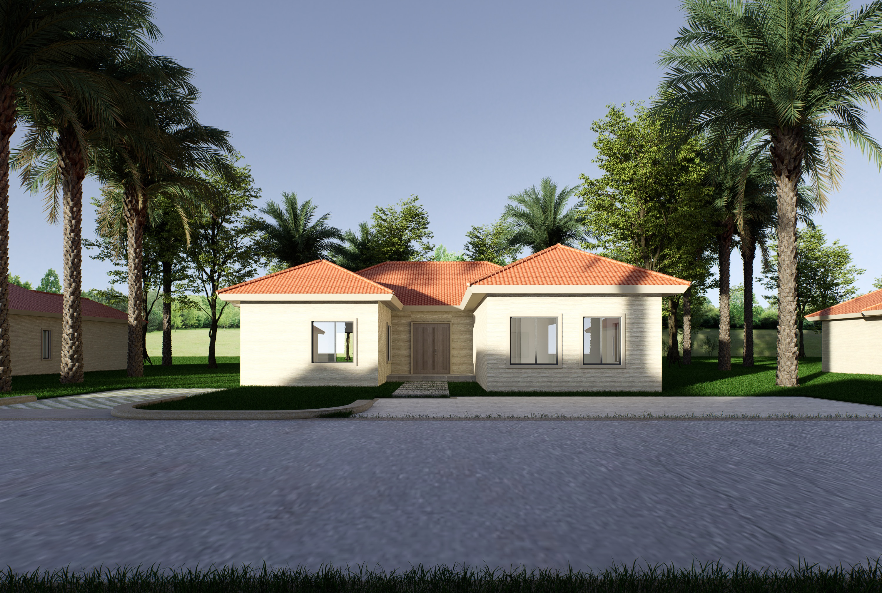
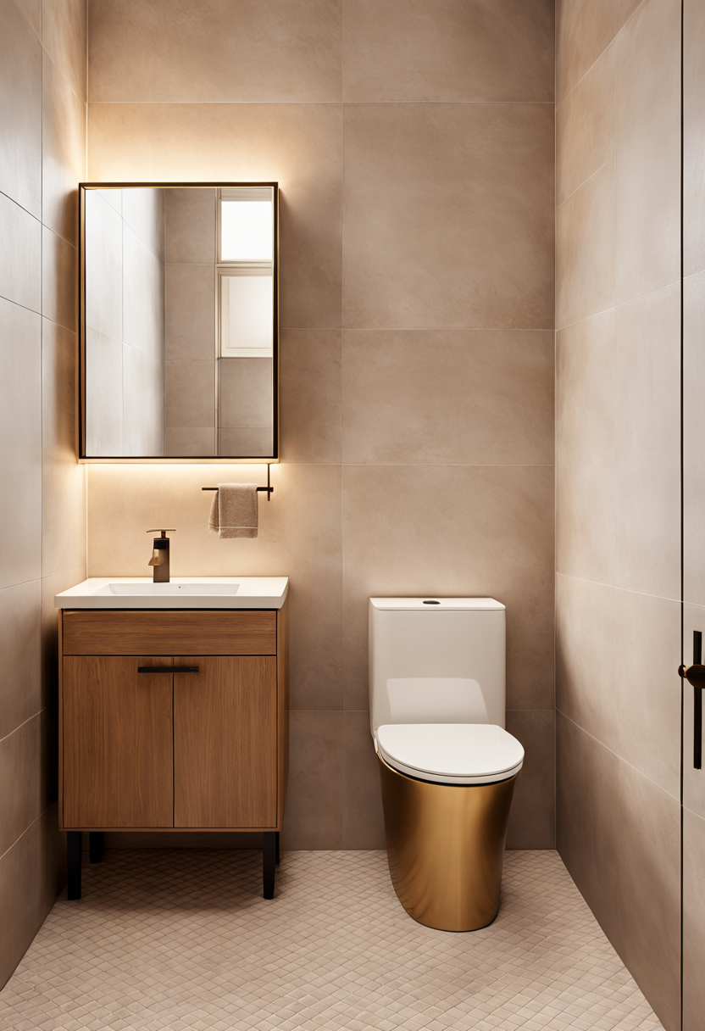
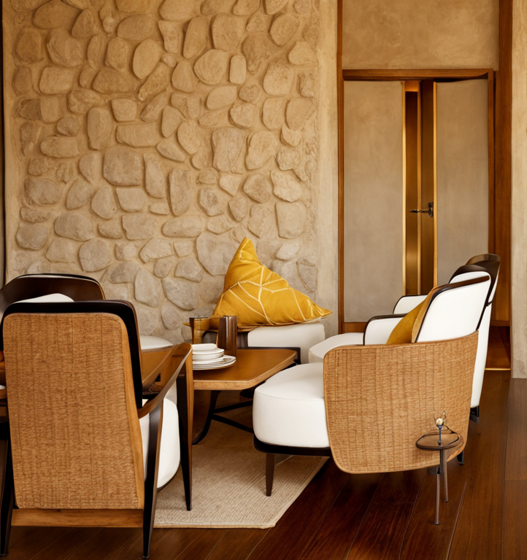
智利别墅
Casa en Chile
平面布置图
Floor Plans
建筑总面积 area
182.06㎡
长宽尺寸 land coverage
13.48m * 19.06m
楼层数量 floor number 1
4
2

Slide 2
Villa en Chile
建筑体型分析
Architectural Analysis
Static Space
Dynamic Space
Functions and Distributions
Active Area: Primarily used for "living" spaces (e.g., reception room, kitchen, dining room)
Static Area: Mainly used by family members (e.g., bedrooms, family room, study)
Circulation

Slide 3
Villa en Chile
建筑体型分析
Architectural Analysis
Floorplan
Section

Slide 4
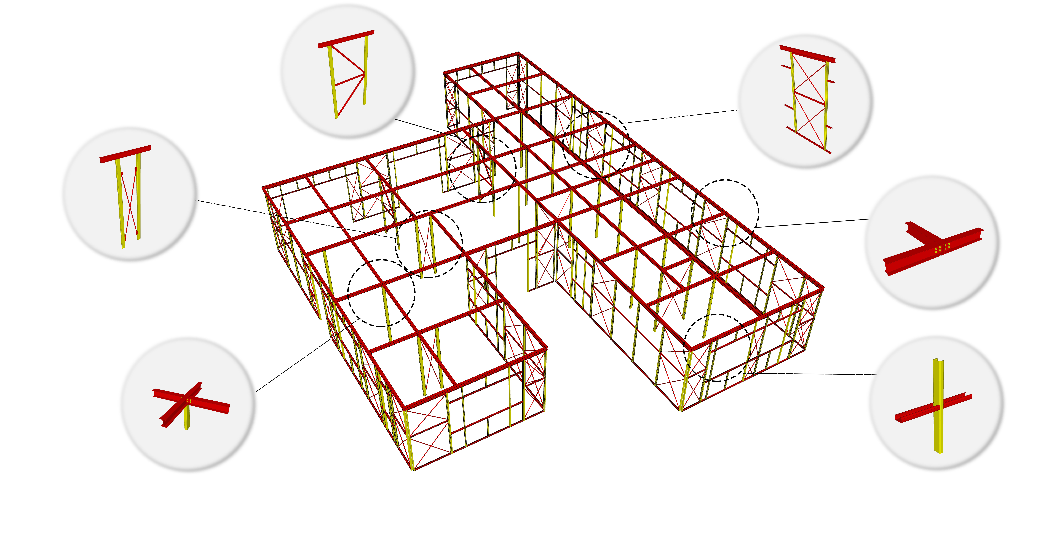
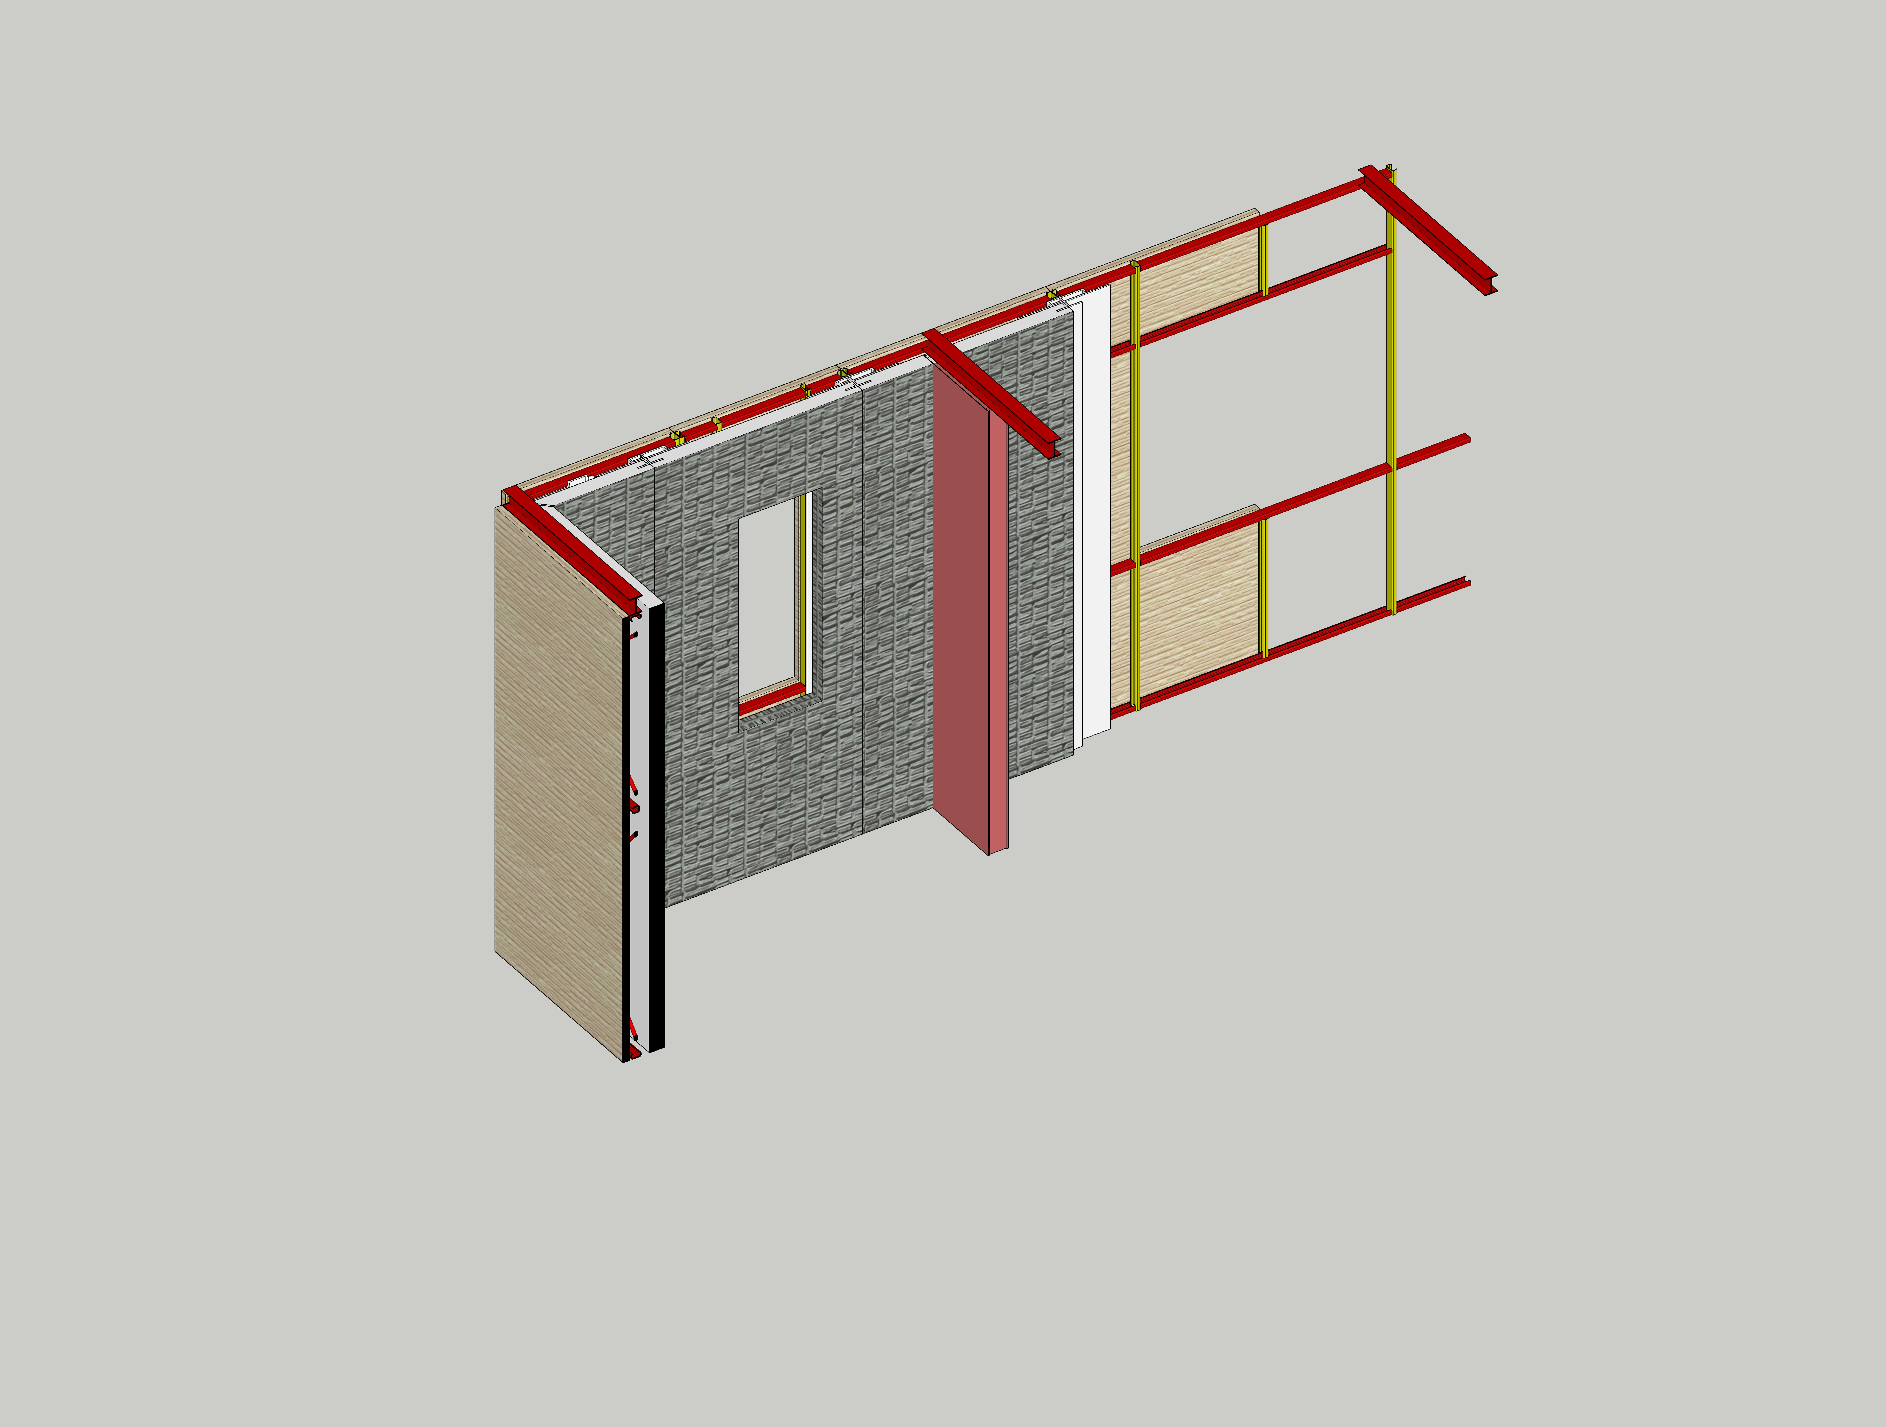
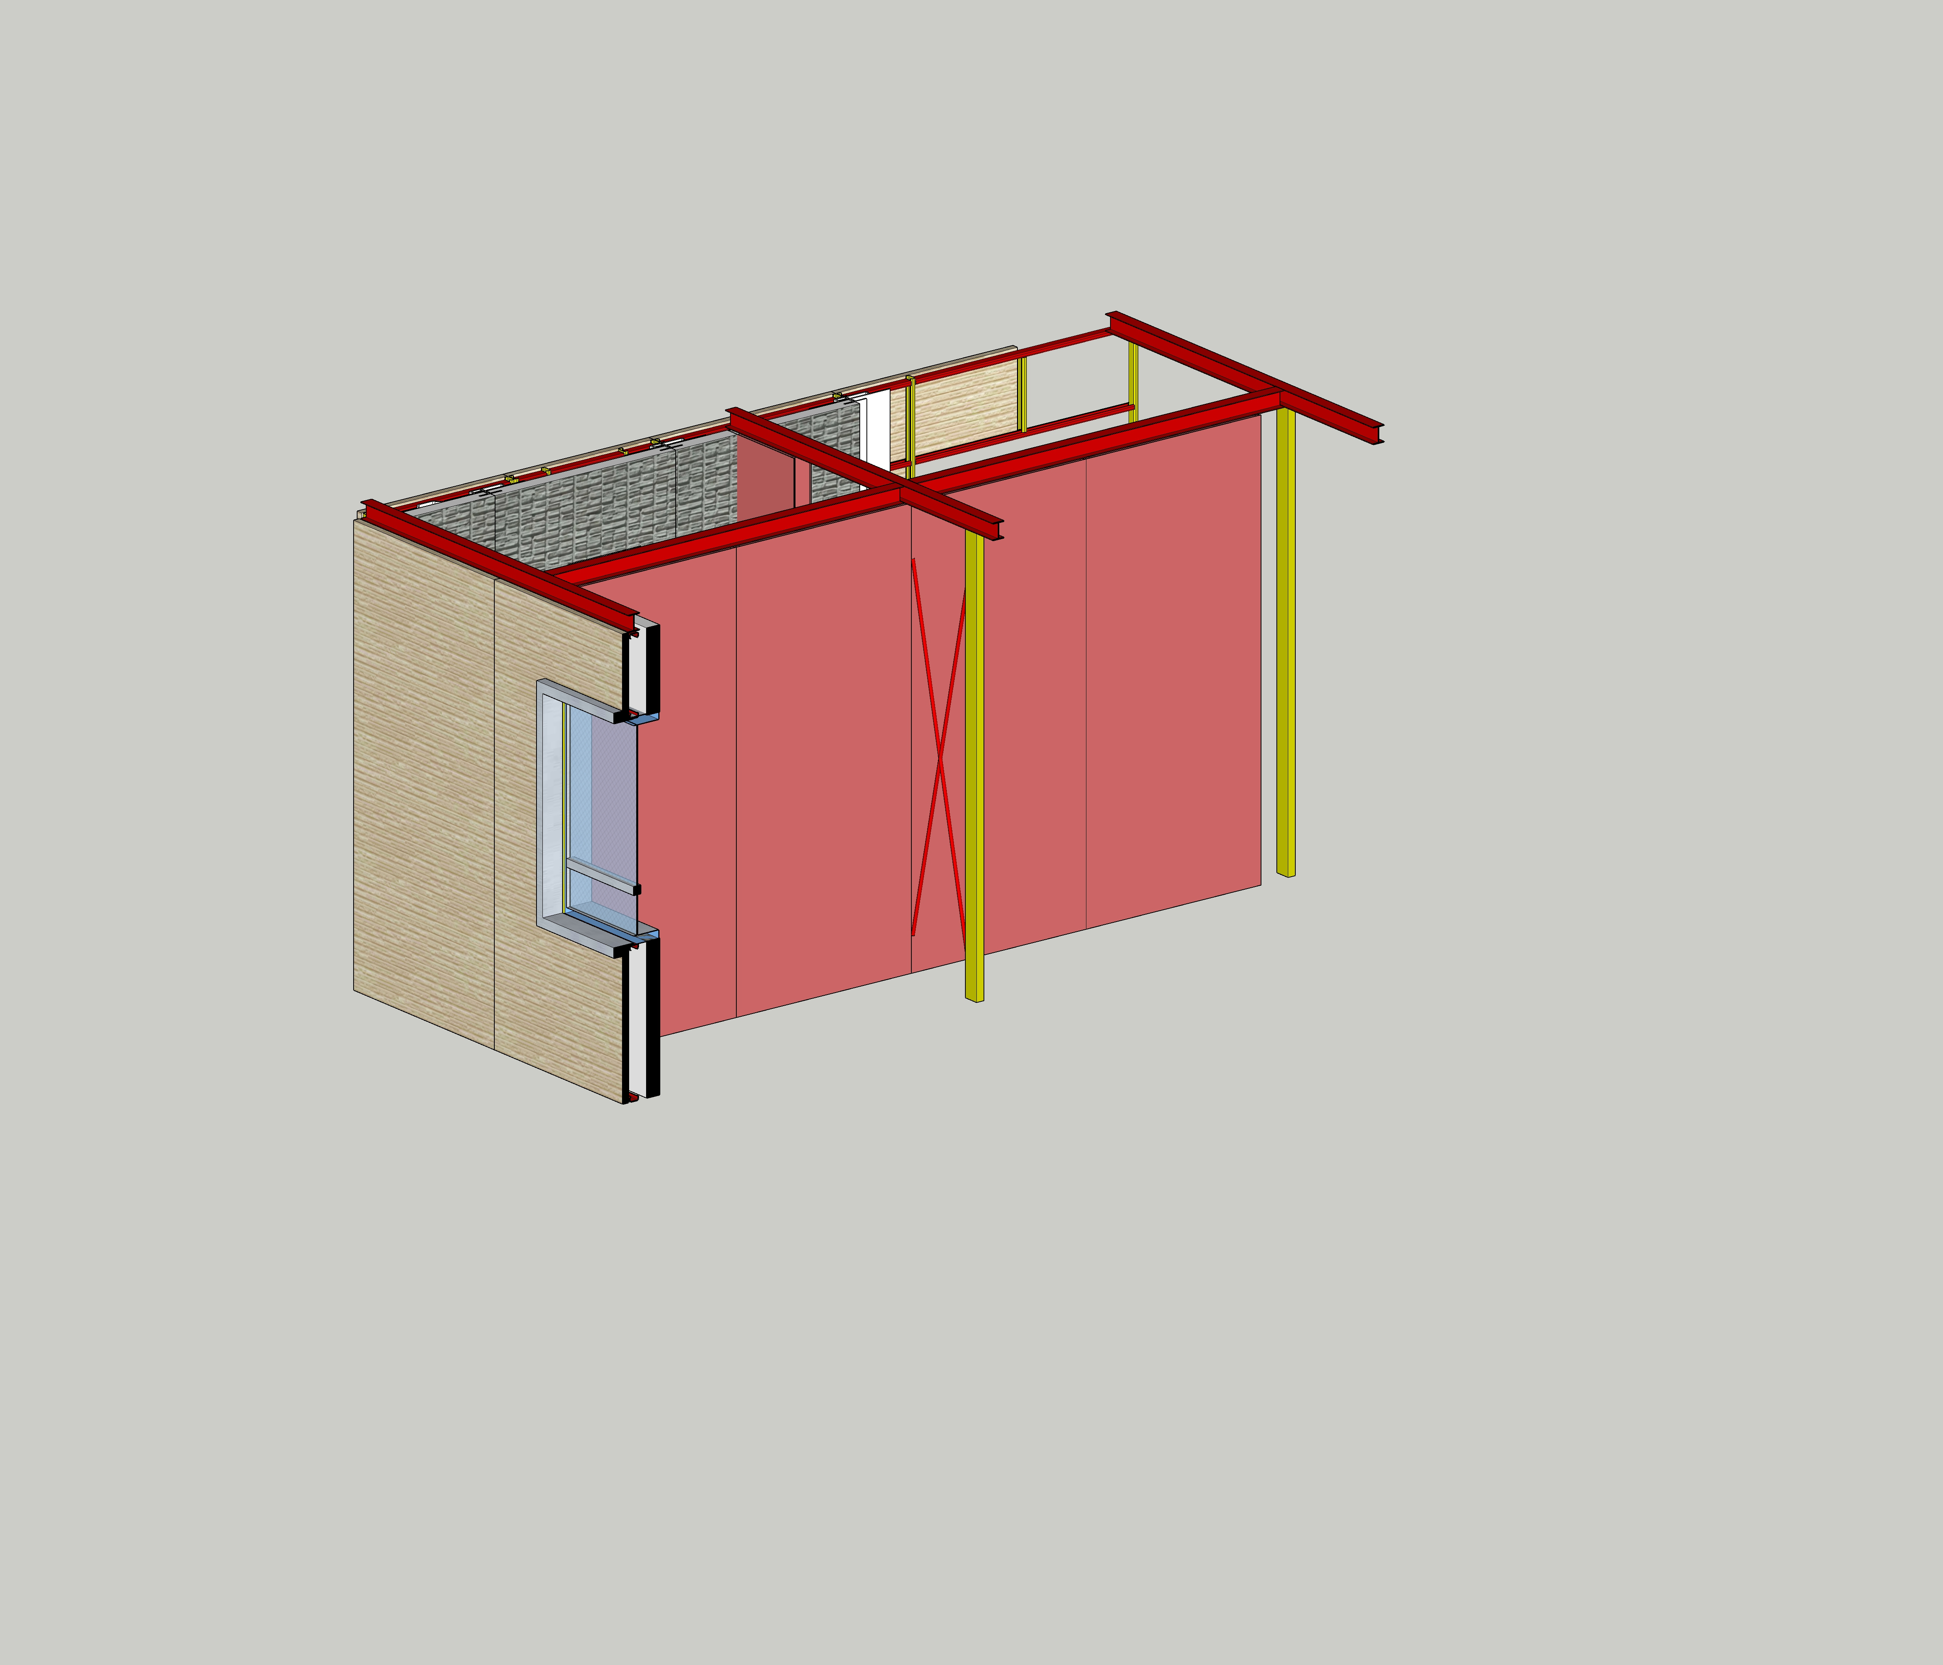
Villa en Chile
建筑结构分析
Structural Analysis
K-Shaped Seismic Components
These are installed in the middle of the building, enhancing the internal space’s ability to resist lateral loads caused by earthquakes. They can be easily concealed within interior partition walls.
Dynamic Structural Frame
Seismic resistent Components
Installed around the building’s perimeter, it provides a flexible seismic “damping” effect for the structure.
Using a steel cable cross-bracing method, the width can be freely adjusted, making it adaptable to any width of interior wall space.
Bolted Connection
A fully bolted connection method is employed, making construction convenient and fast.
Beam and Column
Lightweight Steel Material
Beams and columns are assembled in “Floor by Floor”method, with small cross-section columns minimizing their impact on the interior space.
A large amount of C-shaped lightweight steel is used to reduce the weight of the building's main structure while ensuring structural strength, resulting in improved seismic performance.
An Alternative Seismic Resistent “Concept”
The immense power of nature is beyond human resistance. Rather than confronting it directly, it is better to use flexibility to overcome rigidity. The concept of the dynamic frame structure is to use lightweight, flexible materials to effectively absorb the energy from an earthquake, ensuring the stability of the structure. The steel usage per square meter is 43.4KG (including roof trusses).

Slide 5
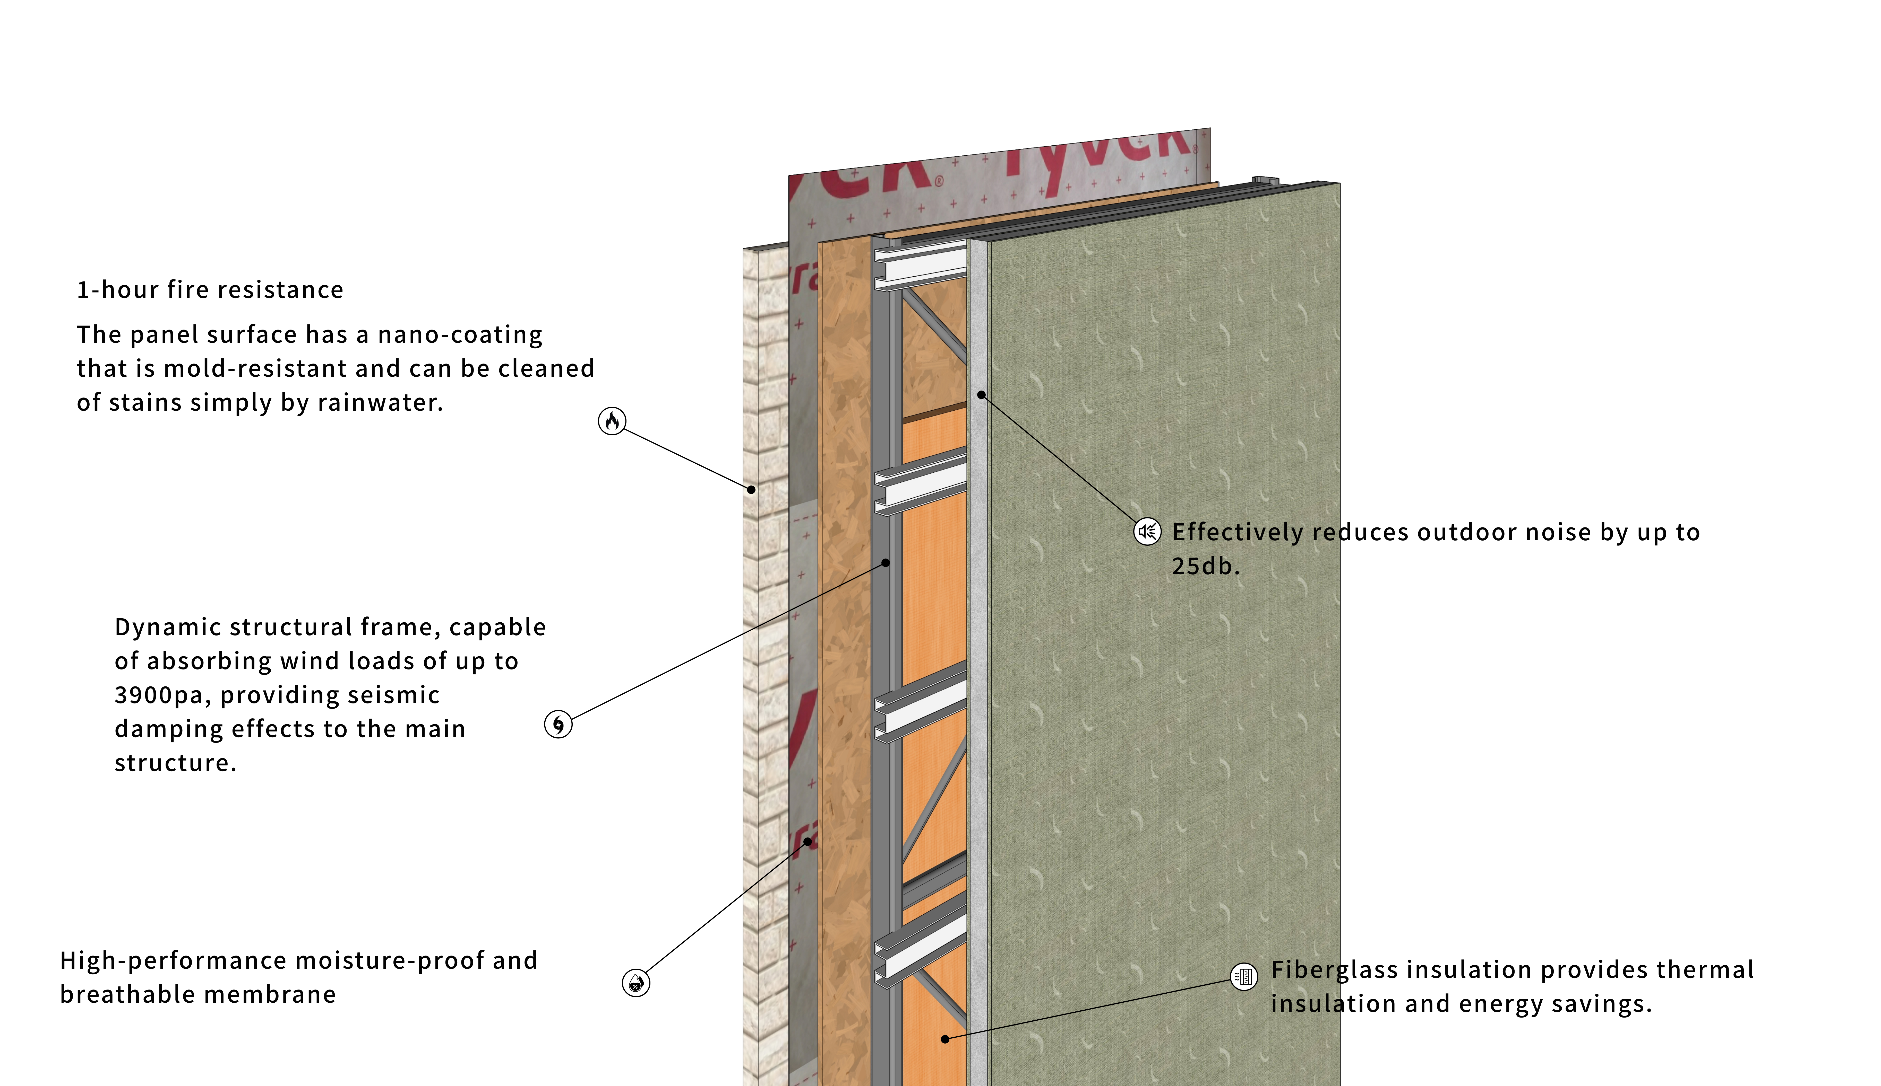
Villa en Chile
建筑隔热、隔音、防潮分析
General Quality Analysis

Slide 6
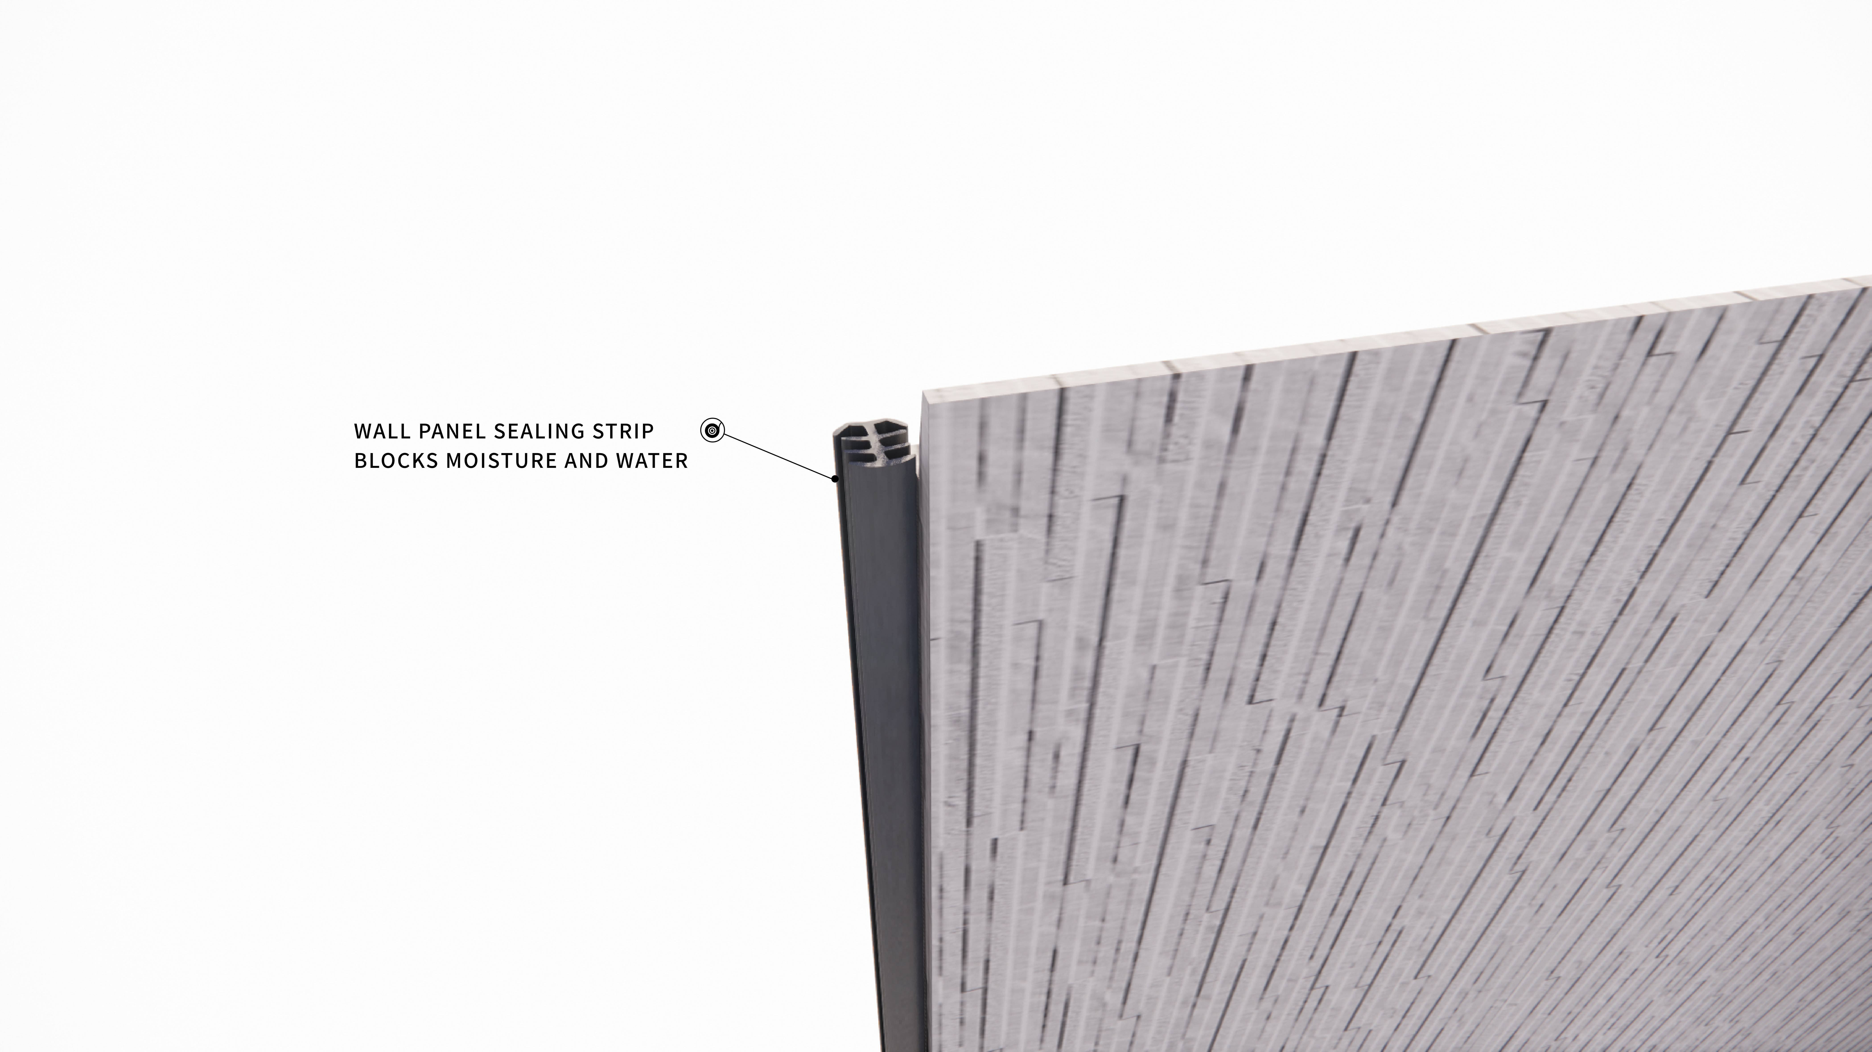
Villa en Chile
建筑隔热、隔音、防潮分析
General Quality Analysis

Slide 7
Villa en Chile
构造分解
Explosive View
Structural Exploded View

